Slide 1
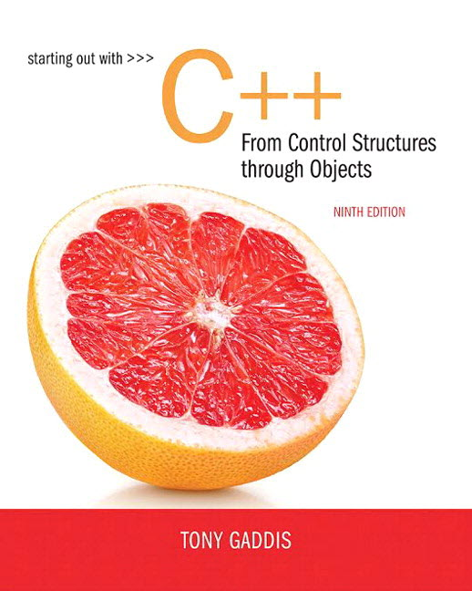
Chapter 5:
Loops and Files

Slide 2
The Increment and Decrement
Operators (1 of 2)
++ is the increment operator.
It adds one to a variable.
  val++; is the same as val = val + 1;
++ can be used before (prefix) or after (postfix) a variable:
  ++val; val++;

Slide 3
The Increment and Decrement
Operators (2 of 2)
-- is the decrement operator.
It subtracts one from a variable.
  val--; is the same as val = val - 1;
-- can be also used before (prefix) or after (postfix) a variable:
  --val; val--;

Slide 4
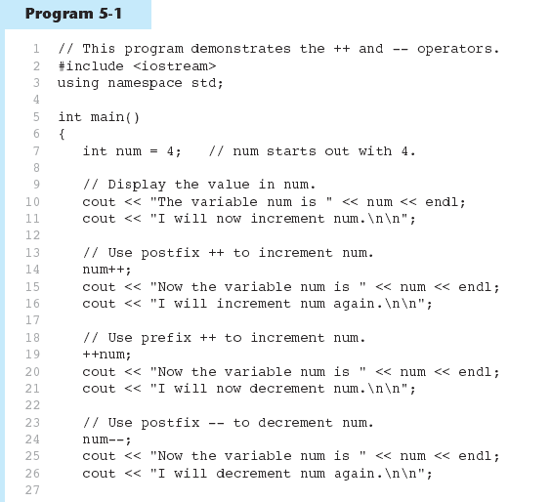
Increment and Decrement
Operators in Program 5-1 (1 of 2)
Continued…

Slide 5
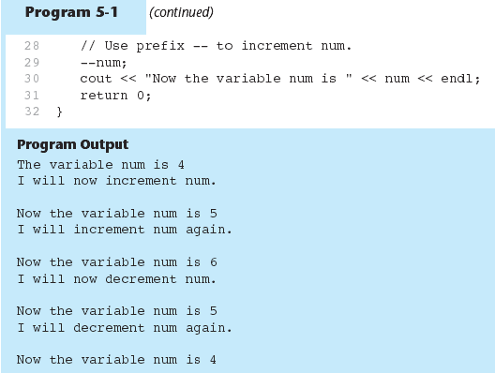
Increment and Decrement
Operators in Program 5-1 (2 of 2)

Slide 6
Prefix vs. Postfix
++ and -- operators can be used in complex statements and expressions
In prefix mode (++val, --val) the operator increments or decrements, then returns the value of the variable
In postfix mode (val++, val--) the operator returns the value of the variable, then increments or decrements

Slide 7
Prefix vs. Postfix - Examples
int num, val = 12;
cout << val++; // displays 12,
// val is now 13;
cout << ++val; // sets val to 14,
// then displays it
num = --val; // sets val to 13,
// stores 13 in num
num = val--; // stores 13 in num,
// sets val to 12

Slide 8
Notes on Increment and Decrement
Can be used in expressions:
  result = num1++ + --num2;
Must be applied to something that has a location in memory. Cannot have:
  result = (num1 + num2)++;
Can be used in relational expressions:
  if (++num > limit)
  pre- and post-operations will cause different comparisons

Slide 9
5.2
Introduction to Loops: The while Loop

Slide 10
Introduction to Loops:
The while Loop
Loop: a control structure that causes a statement or statements to repeat
General format of the while loop:
  while (expression)
  statement;
statement; can also be a block of statements enclosed in { }

Slide 11
The while Loop – How It Works
  while (expression)
  statement;
expression is evaluated
  if true, then statement is executed, and expression is evaluated again
  if false, then the loop is finished and program statements following statement execute

Slide 12
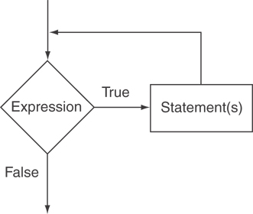
The Logic of a while Loop

Slide 13
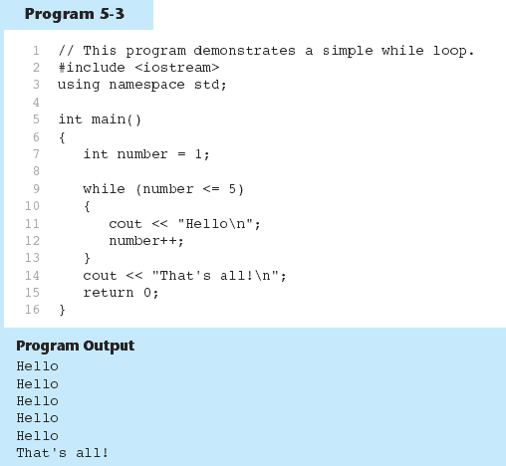
The while loop in Program 5-3

Slide 14
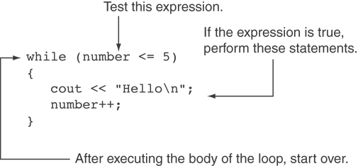
How the while Loop in Program 5-3 Lines 9 through 13 Works

Slide 15
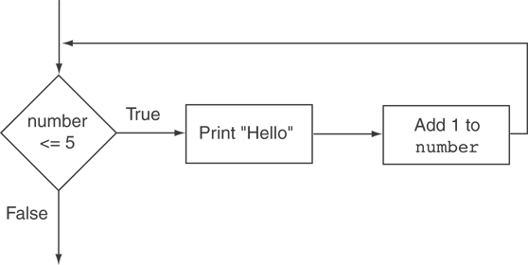
Flowchart of the while Loop in Program 5-3

Slide 16
The while Loop is a Pretest Loop
expression is evaluated before the loop executes. The following loop will never execute:
int number = 6;
while (number <= 5)
{
cout << "Hello\n";
number++;
}

Slide 17
Watch Out for Infinite Loops
The loop must contain code to make expression become false
Otherwise, the loop will have no way of stopping
Such a loop is called an infinite loop, because it will repeat an infinite number of times

Slide 18
Example of an Infinite Loop
int number = 1;
while (number <= 5)
{
cout << "Hello\n";
}

Slide 19
5.3
Using the while Loop for Input Validation

Slide 20
Using the while Loop for Input Validation (1 of 2)
Input validation is the process of inspecting data that is given to the program as input and determining whether it is valid.
The while loop can be used to create input routines that reject invalid data, and repeat until valid data is entered.

Slide 21
Using the while Loop for Input Validation (2 of 2)
Here's the general approach, in pseudocode:
Read an item of input.
While the input is invalid
Display an error message.
Read the input again.
End While

Slide 22
Input Validation Example
cout << "Enter a number less than 10: ";
cin >> number;
while (number >= 10)
{
cout << "Invalid Entry!"
<< "Enter a number less than 10: ";
cin >> number;
}

Slide 23
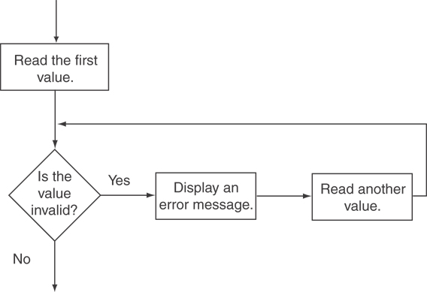
Flowchart for Input Validation

Slide 24
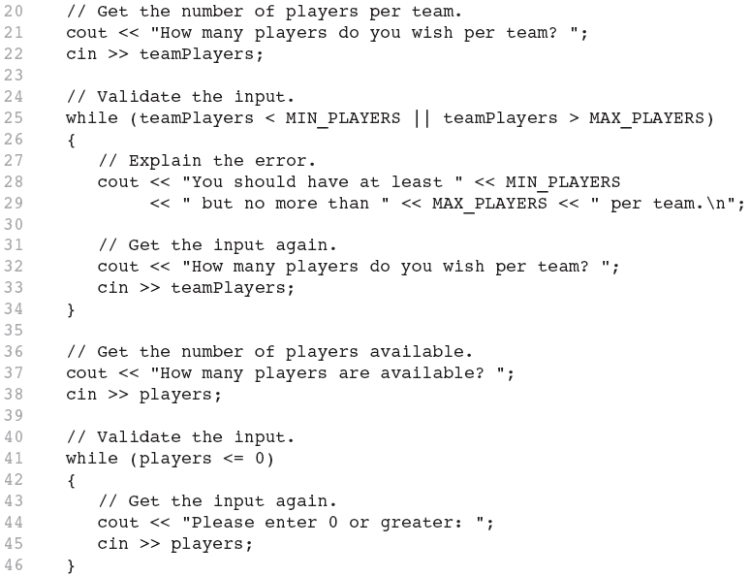
Input Validation in Program 5-5

Slide 25
5.4
Counters

Slide 26
Counters
Counter: a variable that is incremented or decremented each time a loop repeats
Can be used to control execution of the loop (also known as the loop control variable)
Must be initialized before entering loop

Slide 27
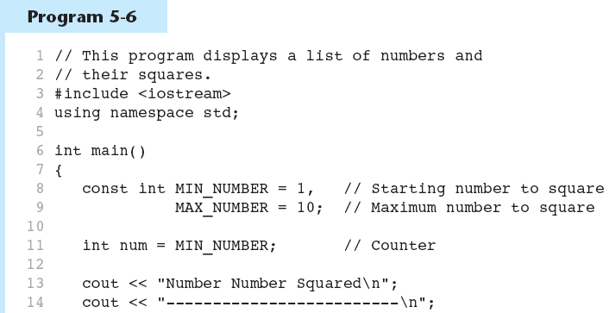
A Counter Variable Controls the Loop in Program 5-6 (1 of 2)
Continued…

Slide 28
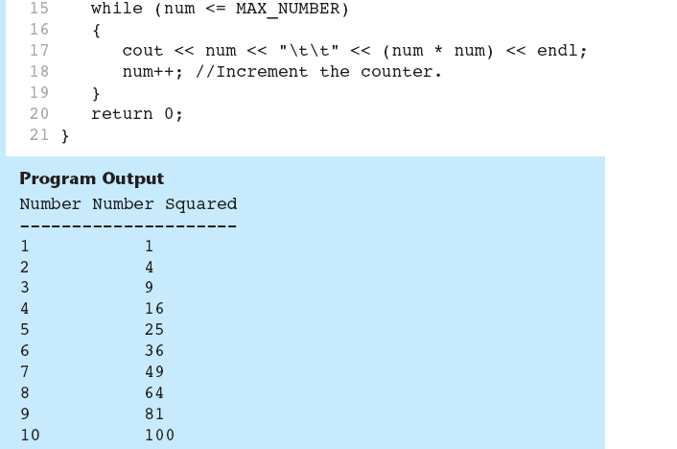
A Counter Variable Controls the Loop in Program 5-6 (2 of 2)

Slide 29
5.5
The do-while Loop

Slide 30
The do-while Loop
do-while: a posttest loop – execute the loop, then test the expression
General Format:
  do
  statement; // or block in { }
  while (expression);
Note that a semicolon is required after (expression)

Slide 31
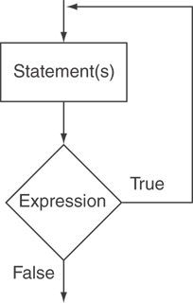
The Logic of a do-while Loop

Slide 32
An Example do-while Loop
int x = 1;
do
{
cout << x << endl;
} while(x < 0);
Although the test expression is false, this loop will execute one time because do-while is a posttest loop.

Slide 33
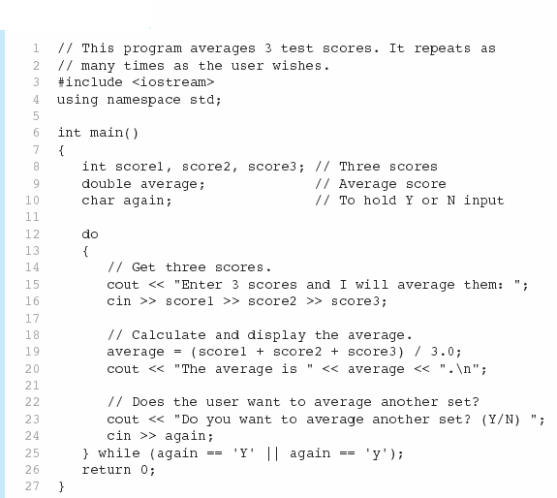

A do-while Loop in Program 5-7 (1 of 2)
Continued…

Slide 34
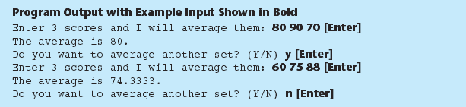
A do-while Loop in Program 5-7 (2 of 2)

Slide 35
do-while Loop Notes
Loop always executes at least once
Execution continues as long as expression is true, stops repetition when expression becomes false
Useful in menu-driven programs to bring user back to menu to make another choice (see Program 5-8 on pages 245-246)

Slide 36
5.6
The for Loop

Slide 37
The for Loop
Useful for counter-controlled loop
General Format:
  for(initialization; test; update)
  statement; // or block in { }
No semicolon after the update expression or after the )

Slide 38
for Loop - Mechanics
for(initialization; test; update)
  statement; // or block in { }
Perform initialization
Evaluate test expression
  If true, execute statement
  If false, terminate loop execution
Execute update, then re-evaluate test expression

Slide 39
for Loop - Example
int count;
for (count = 1; count <= 5; count++)
  cout << "Hello" << endl;

Slide 40
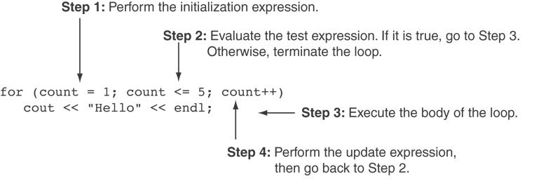
A Closer Look at the Previous Example

Slide 41
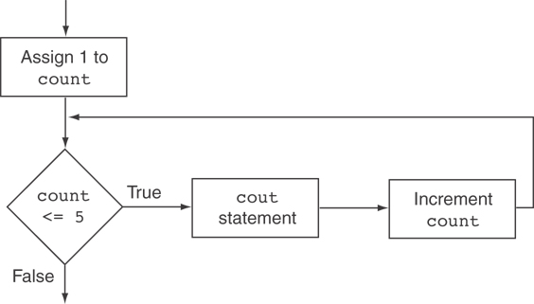
Flowchart for the Previous Example

Slide 42
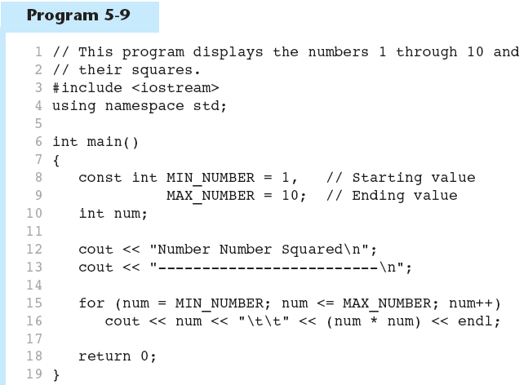
A for Loop in Program 5-9 (1 of 2)
Continued…

Slide 43
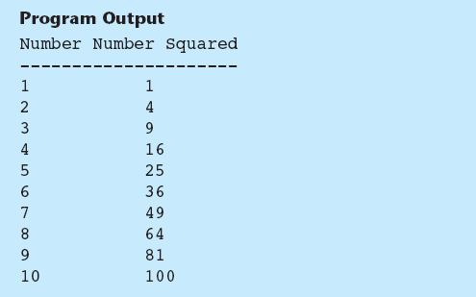
A for Loop in Program 5-9 (2 of 2)

Slide 44
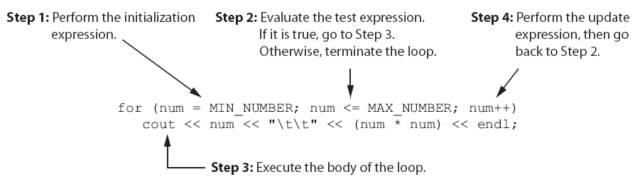
A Closer Look at Lines 15 through 16 in Program 5-9

Slide 45
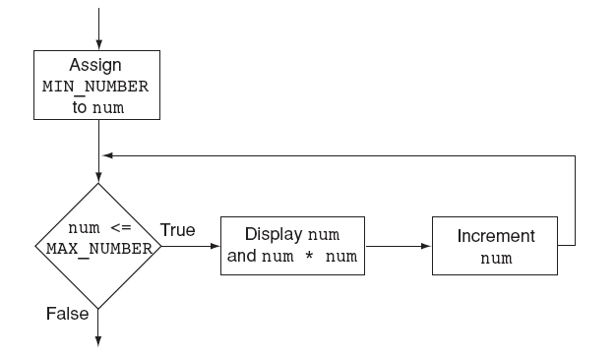
Flowchart for Lines 15 through 16 in Program 5-9

Slide 46
When to Use the for Loop
In any situation that clearly requires
  an initialization
  a false condition to stop the loop
  an update to occur at the end of each iteration

Slide 47
The for Loop is a Pretest Loop
The for loop tests its test expression before each iteration, so it is a pretest loop.
The following loop will never iterate:
for (count = 11; count <= 10; count++)
cout << "Hello" << endl;

Slide 48
for Loop – Modifications (1 of 4)
You can have multiple statements in the initialization expression. Separate the statements with a comma:
int x, y;
for (x=1, y=1; x <= 5; x++)
{
cout << x << " plus " << y
<< " equals " << (x+y)
<< endl;
}
Initialization Expression

Slide 49
for Loop – Modifications (2 of 4)
You can also have multiple statements in the update expression. Separate the statements with a comma:
int x, y;
for (x=1, y=1; x <= 5; x++, y++)
{
cout << x << " plus " << y
<< " equals " << (x+y)
<< endl;
}
Update Expression

Slide 50
for Loop – Modifications (3 of 4)
You can omit the initialization expression if it has already been done:
int sum = 0, num = 1;
for (; num <= 10; num++)
sum += num;

Slide 51
for Loop – Modifications (4 of 4)
You can declare variables in the initialization expression:
  int sum = 0;
  for (int num = 0; num <= 10; num++)
  sum += num;
  The scope of the variable num is the for loop.

Slide 52
5.7
Keeping a Running Total

Slide 53
Keeping a Running Total
running total: accumulated sum of numbers from each repetition of loop
accumulator: variable that holds running total
  int sum=0, num=1; // sum is the
  while (num <= 10) // accumulator
  { sum += num;
  num++;
  }
  cout << "Sum of numbers 1 – 10 is"
  << sum << endl;

Slide 54
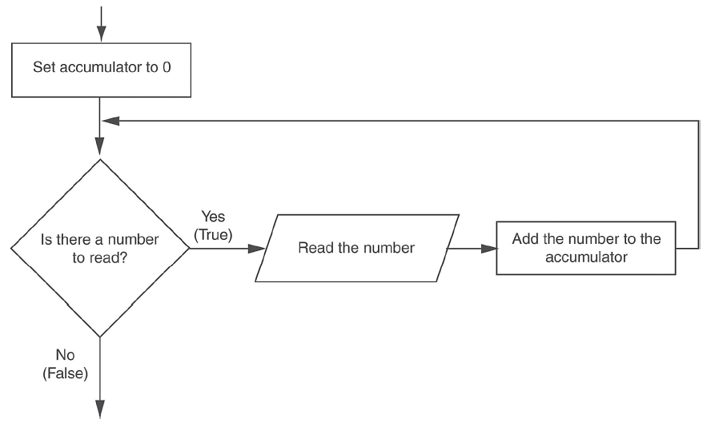
Logic for Keeping a Running Total

Slide 55
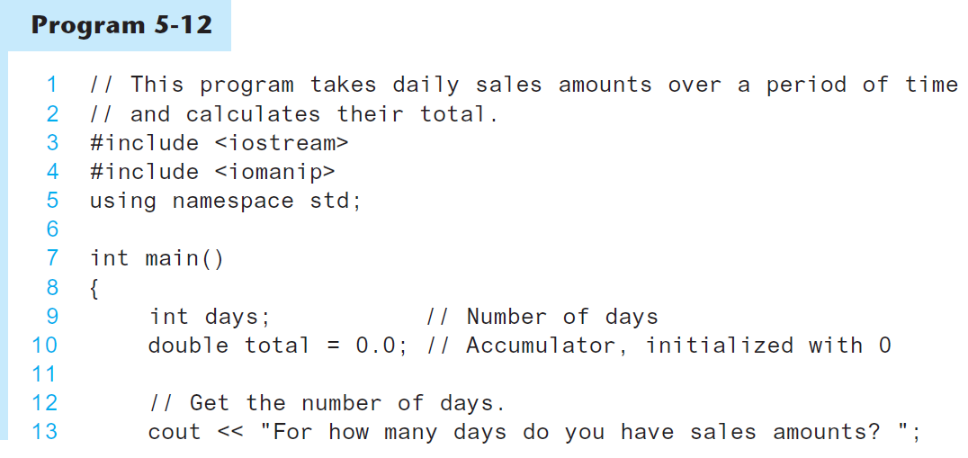
A Running Total in Program 5-12 (1 of 2)
Continued…

Slide 56
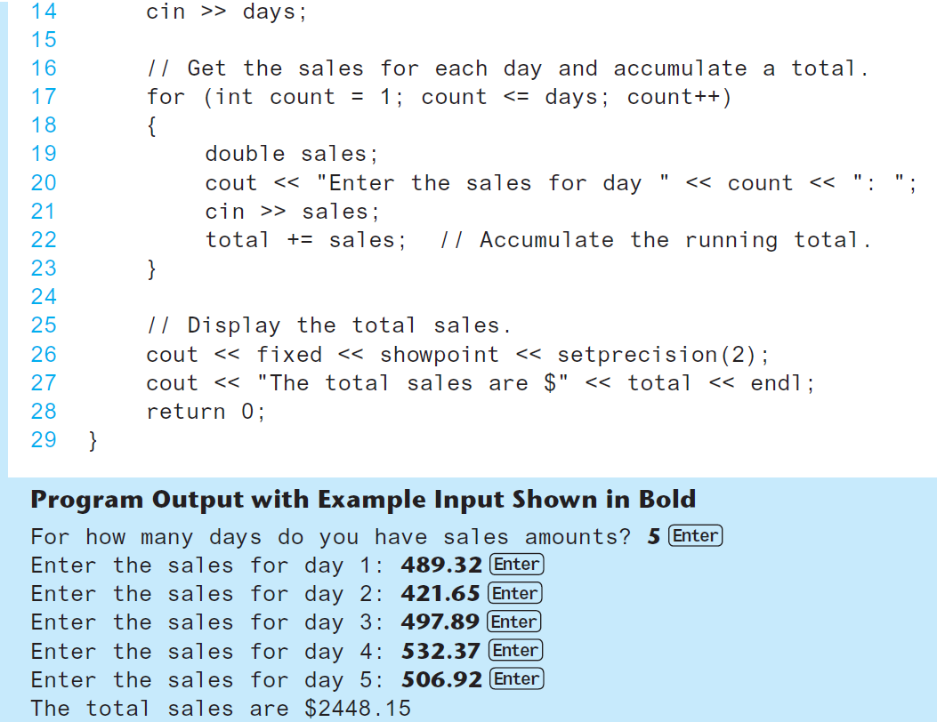
A Running Total in Program 5-12 (2 of 2)

Slide 57
5.8
Sentinels

Slide 58
Sentinels
sentinel: value in a list of values that indicates end of data
Special value that cannot be confused with a valid value, e.g., -999 for a test score
Used to terminate input when user may not know how many values will be entered

Slide 59
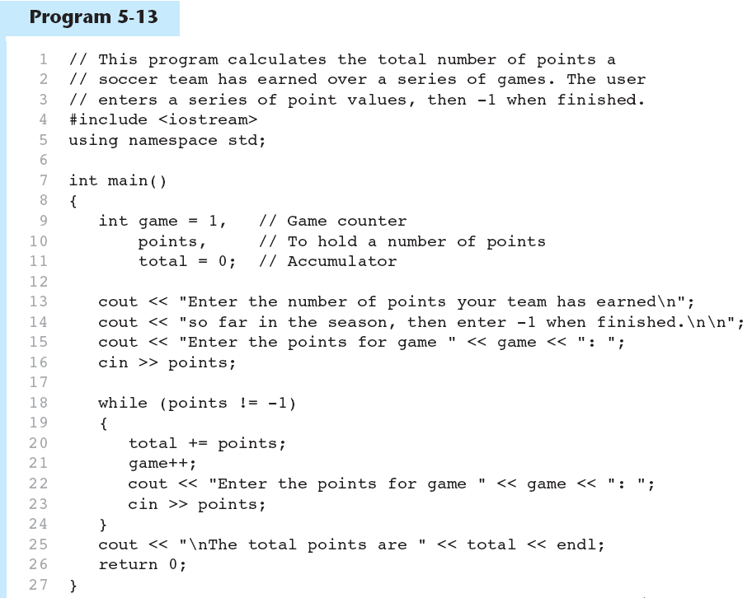
A Sentinel in Program 5-13 (1 of 2)
Continued…

Slide 60
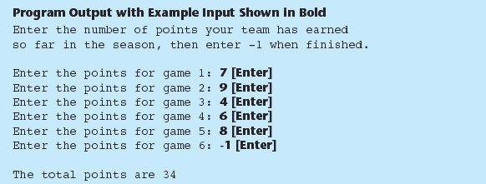
A Sentinel in Program 5-13 (2 of 2)

Slide 61
5.9
Deciding Which Loop to Use

Slide 62
Deciding Which Loop to Use
The while loop is a conditional pretest loop
  Iterates as long as a certain condition exits
  Validating input
  Reading lists of data terminated by a sentinel
The do-while loop is a conditional posttest loop
  Always iterates at least once
  Repeating a menu
The for loop is a pretest loop
  Built-in expressions for initializing, testing, and updating
  Situations where the exact number of iterations is known

Slide 63
5.10
Nested Loops

Slide 64
Nested Loops
A nested loop is a loop inside the body of another loop
Inner (inside), outer (outside) loops:
  for (row=1; row<=3; row++) //outer
  for (col=1; col<=3; col++)//inner
  cout << row * col << endl;

Slide 65
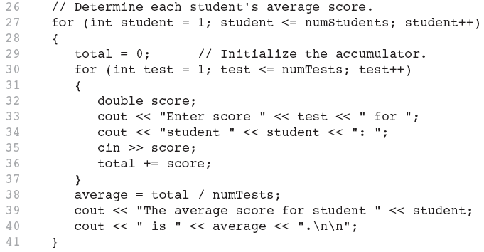
Nested for Loop in Program 5-14
Inner Loop
Outer Loop

Slide 66
Nested Loops - Notes
Inner loop goes through all repetitions for each repetition of outer loop
Inner loop repetitions complete sooner than outer loop
Total number of repetitions for inner loop is product of number of repetitions of the two loops.

Slide 67
5.11
Using Files for Data Storage

Slide 68
Using Files for Data Storage
Can use files instead of keyboard, monitor screen for program input, output
Allows data to be retained between program runs
Steps:
  Open the file
  Use the file (read from, write to, or both)
  Close the file

Slide 69
Files: What is Needed
Use fstream header file for file access
File stream types:
  ifstream for input from a file
  ofstream for output to a file
  fstream for input from or output to a file
Define file stream objects:
  ifstream infile;
  ofstream outfile;

Slide 70
Opening Files
Create a link between file name (outside the program) and file stream object (inside the program)
Use the open member function:
  infile.open("inventory.dat");
  outfile.open("report.txt");
Filename may include drive, path info.
Output file will be created if necessary; existing file will be erased first
Input file must exist for open to work

Slide 71
Testing for File Open Errors
Can test a file stream object to detect if an open operation failed:
  infile.open("test.txt");
  if (!infile)
  {
  cout << "File open failure!";
  }
Can also use the fail member function

Slide 72
Using Files
Can use output file object and << to send data to a file:
  outfile << "Inventory report";
Can use input file object and >> to copy data from file to variables:
  infile >> partNum;
  infile >> qtyInStock >> qtyOnOrder;

Slide 73
Using Loops to Process Files
The stream extraction operator >> returns true when a value was successfully read, false otherwise
Can be tested in a while loop to continue execution as long as values are read from the file:
  while (inputFile >> number) ...

Slide 74
Closing Files
Use the close member function:
  infile.close();
  outfile.close();
Don’t wait for operating system to close files at program end:
  may be limit on number of open files
  may be buffered output data waiting to send to file

Slide 75
Letting the User Specify a Filename
In many cases, you will want the user to specify the name of a file for the program to open.
In C++ 11, you can pass a string object as an argument to a file stream object’s open member function.

Slide 76
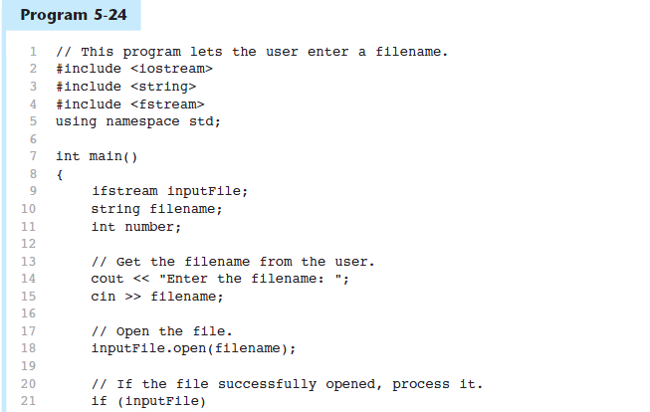
Letting the User Specify a Filename in Program 5-24 (1 of 2)
Continued…

Slide 77
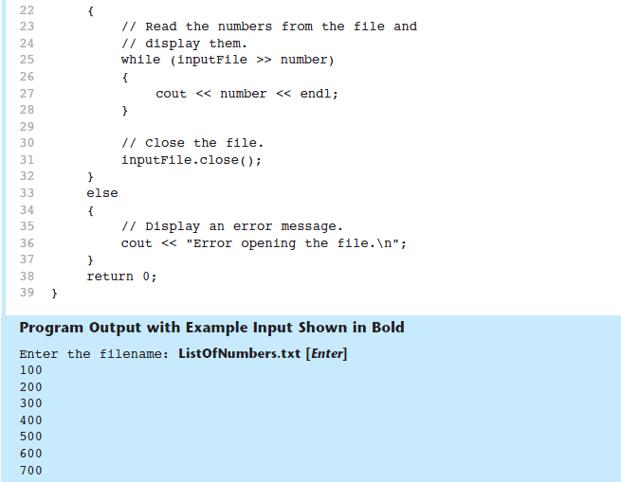
Letting the User Specify a Filename in Program 5-24 (2 of 2)

Slide 78
Using the c_str Member Function in Older Versions of C++ (1 of 2)
Prior to C++ 11, the open member function requires that you pass the name of the file as a null-terminated string, which is also known as a C-string.
String literals are stored in memory as null-terminated C-strings, but string objects are not.

Slide 79
Using the c_str Member Function in Older Versions of C++ (2 of 2)
string objects have a member function named c_str
  It returns the contents of the object formatted as a null-terminated C-string.
  Here is the general format of how you call the c_str function:
stringObject.c_str()
    Line 18 in Program 5-24 could be rewritten in the following manner:
    inputFile.open(filename.c_str());

Slide 80
5.12
Breaking and Continuing a Loop

Slide 81
Breaking Out of a Loop
Can use break to terminate execution of a loop
Use sparingly if at all – makes code harder to understand and debug
When used in an inner loop, terminates that loop only and goes back to outer loop

Slide 82
The continue Statement
Can use continue to go to end of loop and prepare for next repetition
  while, do-while loops: go to test, repeat loop if test passes
  for loop: perform update step, then test, then repeat loop if test passes
Use sparingly – like break, can make program logic hard to follow

